Slide 1
Community Basics
Exploring the Directory

Slide 2

Located in the top banner, click ‘Directory’

Slide 3
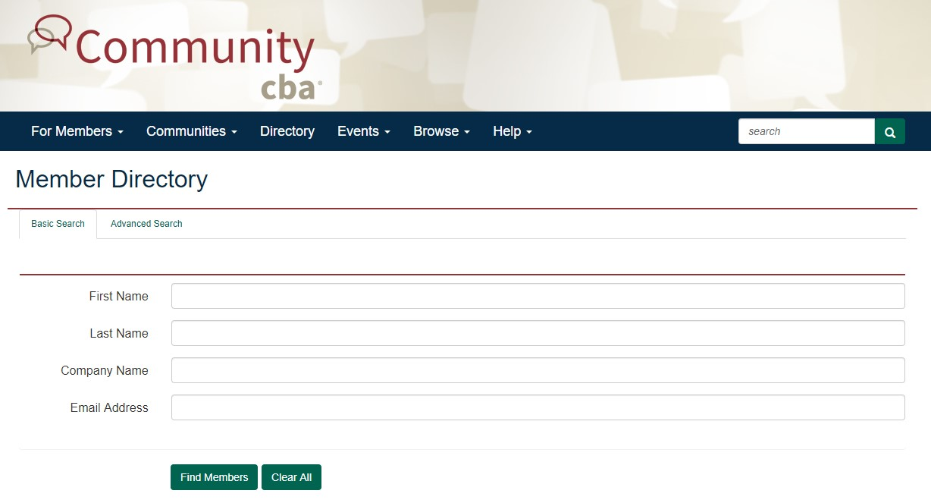

Slide 4
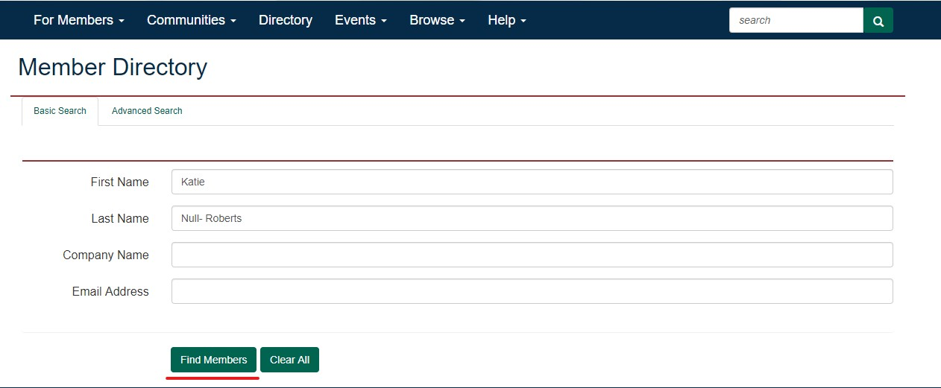
Type in the information of the person you wish to contact, click ‘Find Member’

Slide 5
